Slide 1
Data Science
Introduction
Dr. Juan A. Ferrer-Bonsoms jafhernandez@unav.es

Slide 2
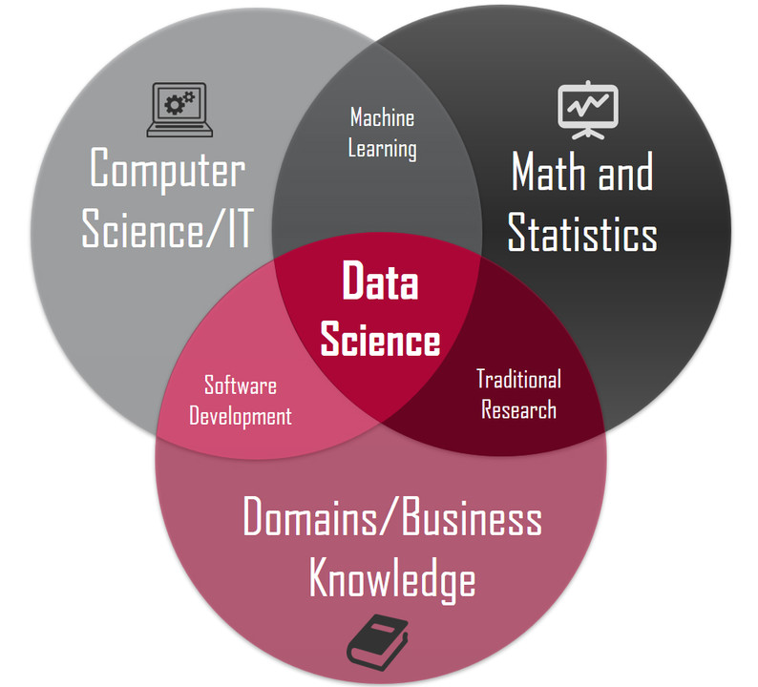
Introduction
Data Science (DS) is the practice of extracting knowledge and insight from data in a reproducible manner, and effectively communicating the results.
Some comments about DS:
DS is the study of data.
Lots of data, open source and free software and algorithms.
DS consists of manipulating, storing and analyzing data.
DS consists of extracting data from unstructured information.
DS is a process of understanding data in order generate valuable insights.
DS helps us to validate a relevant hypothesis objectively.
https://es.linkedin.com/pulse/en-realidad-qu%C3%A9-es-data-science-diego-mart%C3%ADnez-ordo%C3%B1ez

Slide 3
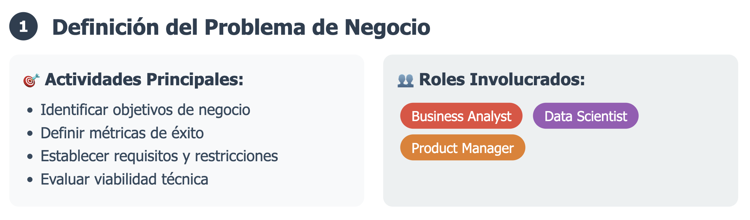
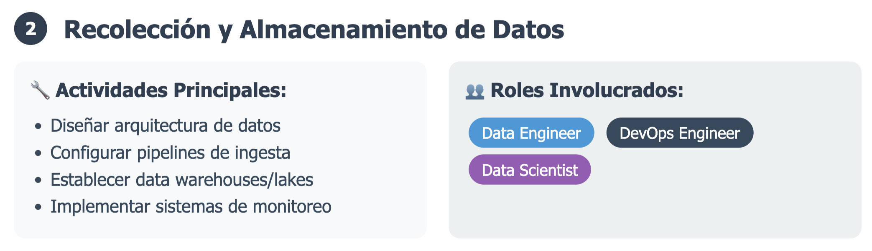
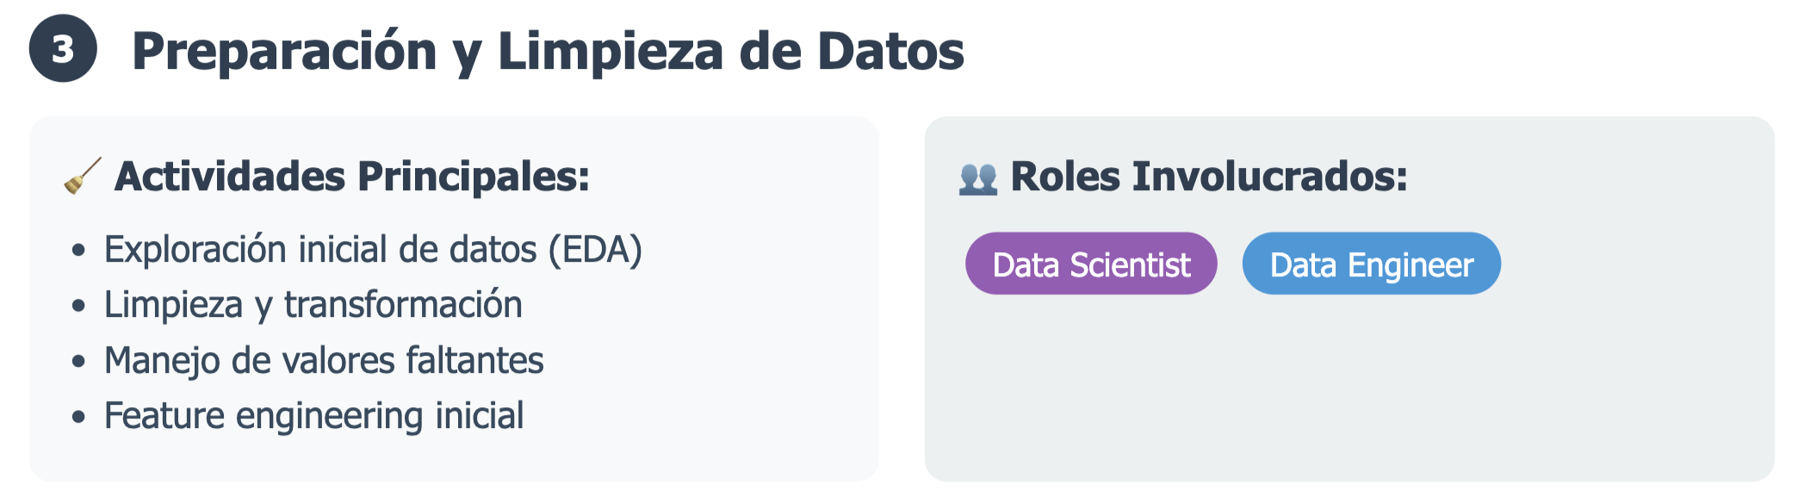
Introduction

Slide 4
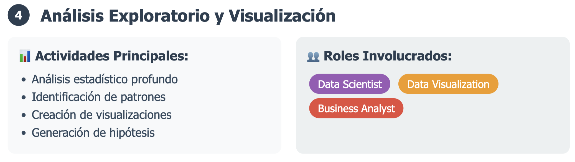
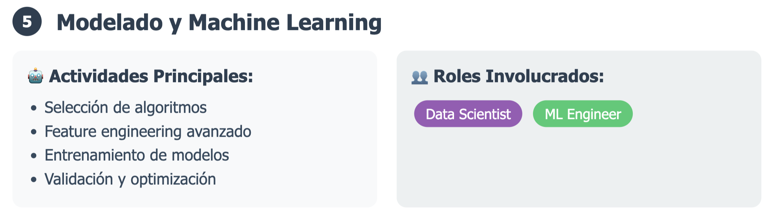
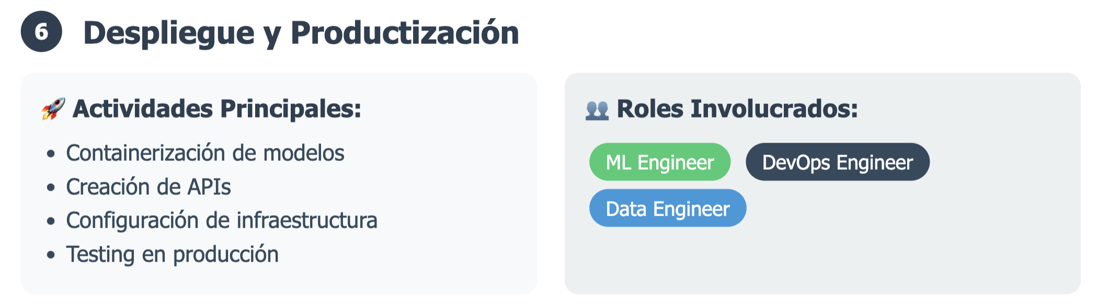
Introduction

Slide 5
Examples
Determining which ad to show a user.
Monitoring an industrial machine to identify leading indicators of failure.
Identifying components on an assembly line that are likely to cause failures.
Identifying genetic variants that explains the difference in the response to drug treatments or anticipate prognosis.
Extracting patterns from web request logs.
Predicting drug toxicity.
Predicting sales.
…

Slide 6
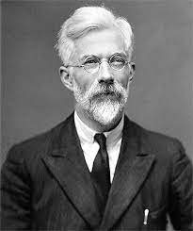
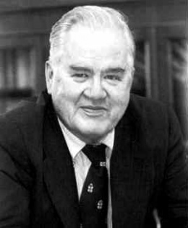
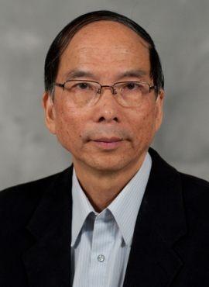
History
The Royal Statistics Society was founded in 1834. Ronald Fisher. Experimental Design and Statistical Inference.
John Tukey in 1962: “For a long time I thought I was a statistician, interested in inferences from the particular to the general. But as I have watched mathematical statistics evolve, I have … come to feel that my central interest is in data analysis… data analysis is intrinsically an empirical science.”
Jeff Wu (currently in Georgia Institute of Technology) in 1997 called for statistics to be renamed data science.

Slide 7
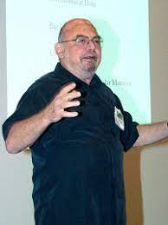

History
Since the beginning of the 21st century, data stockpiles have expanded exponentially.
Advent of computers changed the situation: data models and algorithmic models. (Statistical Modeling, the two cultures, Leo Breiman, 2001)
Algorithmic models included methods from the field of machine learning and deep learning.
Google developed in 2004 MapReduce, software framework that simplified data processing on large cluster. This advance opened the door to Big Data.
Big Data included unstructured data: webpages in HTML, word documents, log files, etc. Conversion into table or numbers.
Machine Learning and Deep Learning
November 2022: ChatGPT

Slide 8
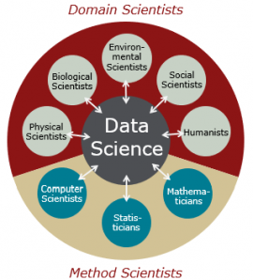
Current Context
DS lies at the intersection of statistical methodology, computational science, and a wide range of application domains.
DS requires a substantial amount of computer skills, but it is different to software/data engineering.
DS requires knowledge about statistics and machine learning in order to apply existing algorithms.
DS is about collecting, storing, curating, cleaning data.
DS is also about data visualization and analysis, and building data-driven models (learning).

Slide 9
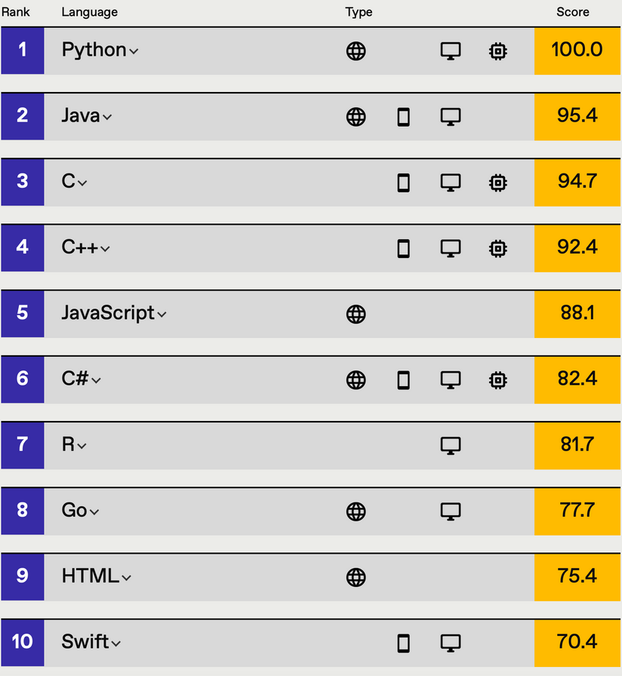
Programming Languages
https://spectrum.ieee.org/top-programming-languages/

Slide 10
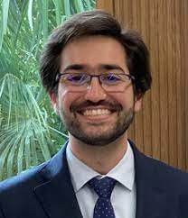
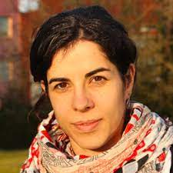
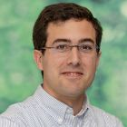
Course
Dr. Juan A. Ferrer-Bonsoms
Dra. Idoia Ochoa
Dr. Rafa Valdés

Slide 11
Course
Fecha | Sesión | Día | Horario | Profesor | Sesión
23/09/2025 | 1 | Martes | 9h-13:30h | Juan Ferrer | Introduction, Data Processing in R
25/09/2025 | 2 | Jueves | 9h-13:30h | Juan Ferrer | Statistical inference II and Visualization in R
26/09/2025 | 3 | Viernes | 9h-13:30h | Rafa Valdés | Experimental design in R
29/09/2025 | 4 | Lunes | 9h-13:30h | Juan Ferrer | Statistical inference III in R and data reduction
01/10/2025 | 5 | Miércoles | 9h-13:30h | Juan Ferrer | Exercises - Assignment - Rmarkdown
03/10/2025 | 6 | Viernes | 9h-13:30h | Rafa Valdés | Linear Regression and GLMs in R
06/10/2025 | 7 | Lunes | 9h-13:30h | Idoia Ochoa | Python Basics
07/10/2025 | 8 | Martes | 9h-13:30h | Idoia Ochoa | Python for Data Science
08/10/2025 | 9 | Miércoles | 9h-13:30h | Juan Ferrer | Introduction to Machine Learning I
13/10/2025 | 10 | Lunes | 9h-13:30h | Juan Ferrer | Exercises - Assignment

Slide 12
Evaluation
2 Assessed Labs: 50% (October 15, November 4)
Course Assignment: 50% (Groups of 2 people) - Deadline 31 October

Slide 13
Data Science
Introduction
Dr. Juan A. Ferrer-Bonsoms jafhernandez@unav.es

